Slide 1

(Secure Hash Algorithm) SHA -512

Slide 2
History of SHA -512
The original specification of the algorithm was published in 1993 under the title Secure Hash Standard (SHA-0), by U.S government standards agency NIST.
It was withdrawn by the NSA shortly after publication and was superseded by the revised version, published in and commonly designated SHA-1.
SHA-1 is a cryptography hash function which takes an input and produces a 160-bit hash value known as a message digest – typically rendered as a hexadecimal number, 40 digits long.

Slide 3
History of SHA -512
Since 2005, SHA-1 has not been considered secure against well-funded opponents.
As of 2010 many organizations have recommended its replacement.
NIST formally deprecated use of SHA-1 in 2021 and disallowed its use for digital signature in 2013.
The predecessor is SHA-2. SHA-2 includes significant changes from its predecessor, SHA-1.
The SHA-2 family consists of six hash function with digests (hash values) that are 224, 256, 384, or 512 bits: SHA-224, SHA-256, SHA- 384, SHA- 512, SHA- 512/224, SHA- 512/256. SHA- 256 and SHA- 512 are novel hash functions computed with 32-bit and b4-bit words, respectively.

Slide 4
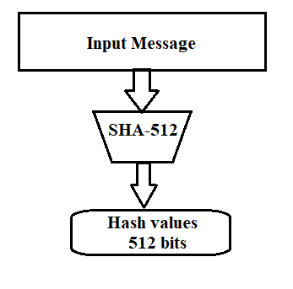
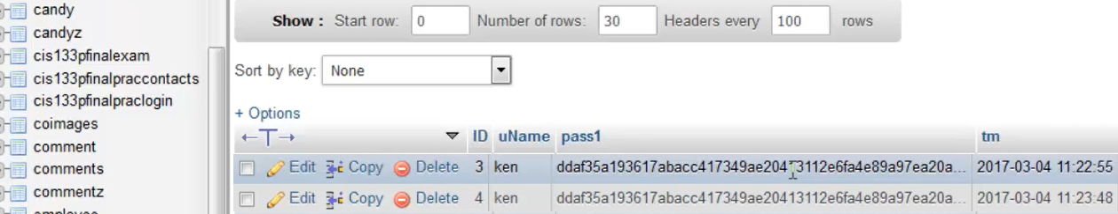
Overview of SHA - 512
SHA-512 create a digest of 512 bits
from multiple block message.
Each block is 1024 bits in length.

Slide 5
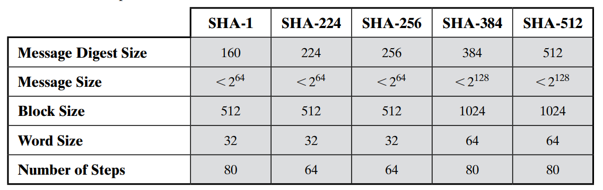
SHA -512 (Secure Hash Algorithm)
SHA – 512 does it work in a few stages.
Append padding bits
Append length
Initialize hash buffer
Process Message
Output
Characteristics of SHA

Slide 6
Step 1: Message Preparation
SHA-512 insists that the length of the original message be less than 2¹²⁸ bits.
If the length of a message >= 2¹²⁸ , it will not be processed.
Padding and length field:
we need to pad the original message to make the length a multiple of 1024.
The length of the padding field can be calculated as follows:
(|M| + |P| + 128) = 0 mod 1024
|P| = (-|M| - 128) mod 1024
where |P| - length of padding bits.
|M| - length of original message.
After padding, add the length of original message as 128 bits at the end

Slide 7
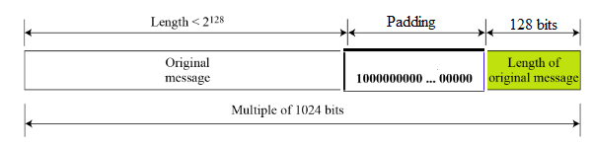
Example:
What is the number of padding bits if the original message length is 2348?
Given; M = 2348
|P| = (-|M| - 128) mod 1024
= (-2348 - 128) mod 1024
= - 2476 mod 1024 = 1024 – (2476 mod 1024) = 596
Therefore, |P| = 596
Then after padding we add 128 bits at the end to represent the length 2348.
So, total bits will be 2348 + 596+ 128 = 3072 bits
Number of 1024 blocks = 3072/1024 = 3
Notes:
596

Slide 8
Another Approach:
What is the number of padding bits if the original message length is 24?
Given; M = 24
MessageLength Ξ 896 mod 1024
24 mod 1024 = 896 mod 1024
24+872 = 896 mod 1024
Therefore, |P| = 872
Then after padding we add 128 bits at the end to represent the length 24.
So, total bits will be 24 + 872+ 128 = 1024 bits
Number of 1024 blocks = 1024/1024 = 1
Notes:
596

Slide 9
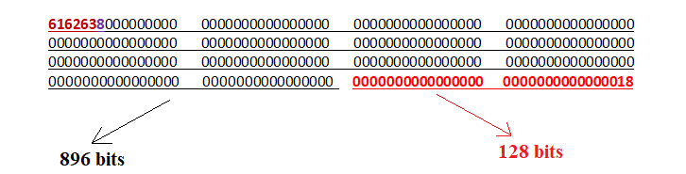
Example
ASCII characters: “abc,” which is equivalent to the following 8 * 3 =24-bit binary string:
0110 0001 0110 0010 0110 0011
MessageLength Ξ 896 mod 1024, i.e 24 Ξ 896 mod 1024
Padding consists of 24 +872 = 896 mod 1024.
872bits, consisting of a “1” bit followed by 871 “0” bits.
6162638000000000 0000000000000000 0000000000000000 0000000000000000 0000000000000000 0000000000000000 0000000000000000 0000000000000000 0000000000000000 0000000000000000 0000000000000000 0000000000000000 0000000000000000 0000000000000000
Then a 128-bit length value is appended to the message, which contains the length of the original message (before the padding).
The original length is 24 bits, or a hexadecimal value of 18. Putting this all together, the 1024-bit message block, in hexadecimal,
Notes:
NOTE: ASCII values of A,B,C are 65,66,67 respectively.
24+40=64
832+40=872
13*64=832bits
Hexadecimal of 24 is 18

Slide 10
Step 1: Message Preparation
How many bits should be padded in SHA-512 for the input message of length 2590 bits?
Notes:
2590 congruent to 896 mod 1024
2590 mod 1024=542
542+354=896
2590+354+128=3072
3072/1024=3
-------------
Methd2
------------
(-2590-128) mod 1024
-2718 mod 1024
1024-(2718 mod 1024)
1024-670
354

Slide 11
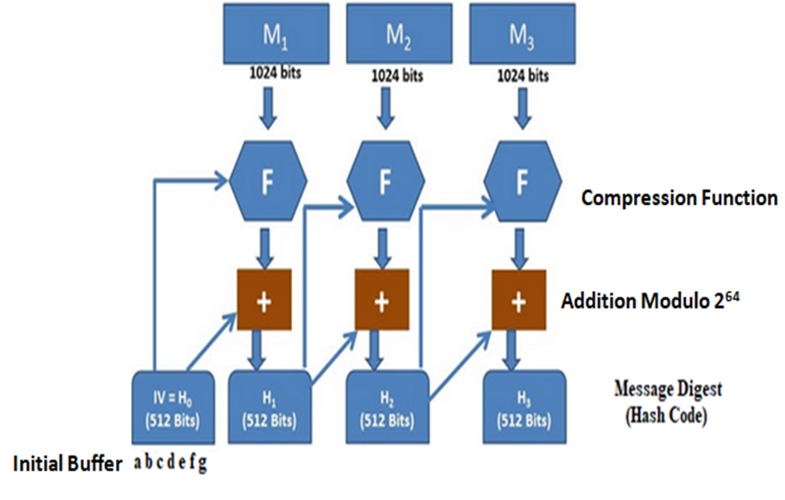
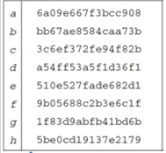
Overall Block Diagram of SHA-512
Notes:
Each letter corresponds to 64 bit
Each letter has 16 * 4 =64 bits
64*8=512 bits
Addition modulo 2 ^64=If A = 14, B = 17, and C =2^64, then (A + B) mod C = (14 + 17) mod 2^64

Slide 12
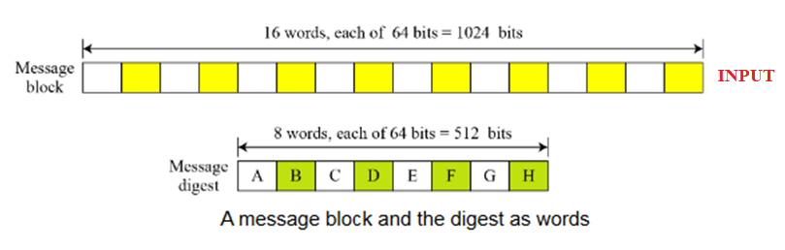
Step 2: Words Expansion
Words:
SHA-512 operates on words of 64 bits.
This means that after the padding and the length field are added to the message, each block of the message consists of sixteen 64-bits words.
The message digest also made of 64-bit words, but it is only eight words that named as A, B, C, D, E, F, G, and H.
Notes:
64 bit =1 word
64*16=1024

Slide 13
Step 2: Words Expansion
Before processing, each message block must be expanded to 1024 bits, or sixteen 64-bit words.
The 16-word blocks needs to be expanded to 80 words, from W₀ to W₇₉.
The 1024-bit block become the first 16 words; the rest of the words come from already-made words according to the operation.
Notes:
16* 64=1024

Slide 14
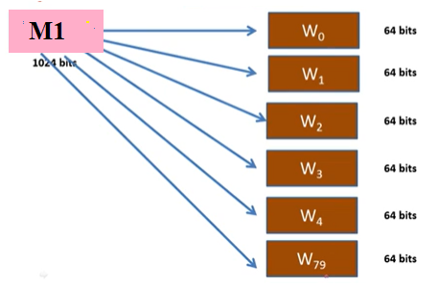
Step 2: Words Expansion
Notes:
Each word is 64 bits- we generate 80 words

Slide 15
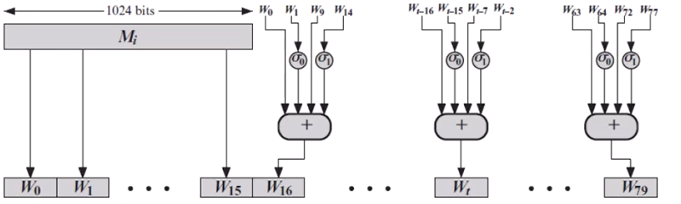
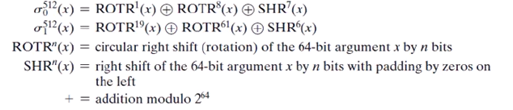
Step 2: Words Expansion
Notes:
The 1024-bit block become the first 16 words
Word1is fed to sigma 0
Word14 is fed to sigma1
Sigma takes a word as a input
Rotr- right circular shift of 1 bit, 8 bit
SHR – right shift of 7 bits

Slide 16
Step 2: Words Expansion Example
Show how W₆₀ is made.
Each word in the range W₁₆ to W₇₉ is made from four previously-made words.
As we know,
W_{t} = W_{t-16} ⊕ RotShift₁₋₈₋₇ (W_{t-15}) ⊕ W_{t-17} ⊕ RotShift₁₉₋₆₁₋₆ (W_{t-2})
W₆₀ is made as
W₆₀ = W₄₄ ⊕ RotShift₁₋₈₋₇ (W₄₅) ⊕ W₅₃ ⊕ RotShift₁₉₋₆₁₋₆ (W₅₈)

Slide 17
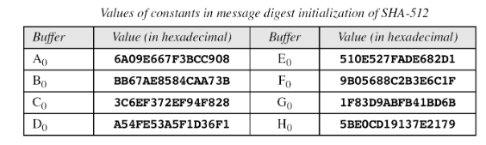
Step 3: Message Digest Initialization
The algorithm uses eight constant for message digest initialization.
We call these constants A₀ to H₀ to match the word naming used for the digest.
Notes:
16 * 4=64 bitd

Slide 18
Step 4: Compression Function (F)
SHA-512 creates a 512-bit (eight 64-bit words) message digest from a multiple-block message where each block is 1024 bits.
The processing of each block of data in SHA-512 involves 80 rounds.

Slide 19
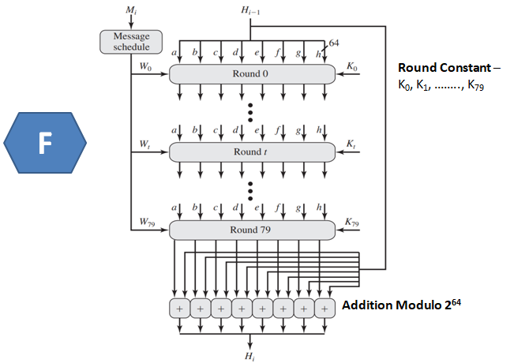
Function (F) – Process of single 1024 block
Notes:
K is the round constant fed
64 * 8 =512 bits

Slide 20
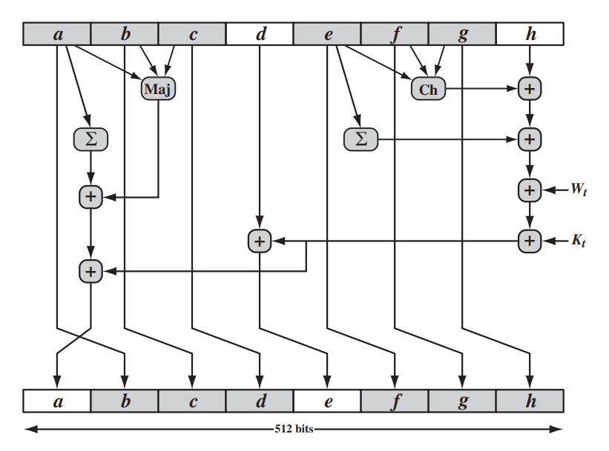
Single Round Operation
Notes:
Each is 64 bits, and total is 512 bits
Ho is the inititaliion vector fed
T1 and T2 are the 2 computations
‘

Slide 21
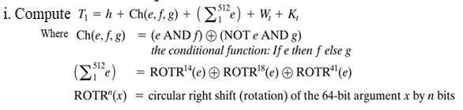
Compute T1
Notes:
Ch is condition function
Sigma 512 e
If round1 , then W1 and K1
e.f,g are from input buffer

Slide 22
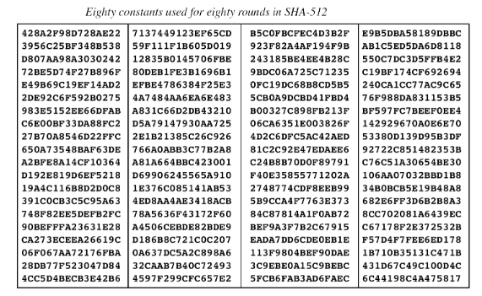
Notes:
80 different round constants
20 round constants in a column
20 * 4 =80 round constants
Each 64 bits of round constants

Slide 23
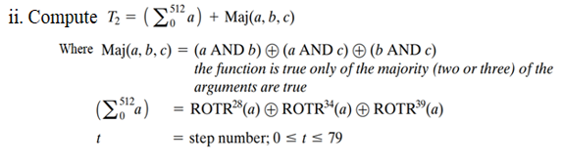
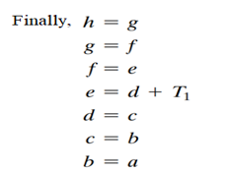
Compute T2
a =T1+T2
Notes:
Majority function that takes a,b,c
A, b c is from input buffer
---------------
A is taken move to b

Slide 24
Single Round Operation
Notes:
Each is 64 bits, and total is 512 bits
Ho is the inititaliion vector fed
T1 and T2 are the 2 computations
‘

Slide 25
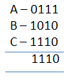
Example
Apply the Majority function on buffers A, B, and C. If the leftmost hexadecimal digits of these buffers are 0x7, 0xA, and 0xE, respectively, what is the leftmost digit of the result?
Solution:
The digits in binary are 0111, 1010, and 1110.
The first bits are 0, 1, and 1. The majority is 1.
The second bits are 1, 0, and 1. The majority is 1.
The third bits are 1, 1, and 1. The majority is 1.
The fourth bits are 1, 0, and 0. The majority is 0.
The result is 1110, or 0xE in hexadecimal.

Slide 26
Example
Apply the Conditional function on E, F, and G buffers. If the leftmost hexadecimal digits of these buffers are 0x9, 0xA, and 0xF respectively, what is the leftmost digit of the result?
Solution:
The digits in binary are 1001, 1010, and 1111.
a. The first bits are 1, 1, and 1. The result is F1, which is 1.
b. The second bits are 0, 0, and 1. The result is G2, which is 1.
c. The third bits are 0, 1, and 1. The result is G3, which is 1.
d. The fourth bits are 1, 0, and 1. The result is F4, which is 0.
The result is 1110, or 0xE in hexadecimal.

Slide 27
Example
Consider you wish to hash a one block message consisting of 4 ASCII characters “CDEF” using secure hash algorithm SHA-512. Note that the ASCII values of C,D,E,F are 67,68,69,70 respectively.
Answer the following:
Find the number of padding bits.
Show the sixteen 64 bit words (W₀ to W₁₅) in hexa-decimal format.
If you apply the majority function of round operation on buffers A, B, and C. If the rightmost binary bits of these buffers are (111010)₂, (001100)₂, and (110011)₂, respectively, what is the rightmost bits of the result?
If you apply the condition function of round operation on buffers E, F, and G. If the leftmost binary bits of these buffers are (111010)₂, (001100)₂, and (110011)₂, respectively, what is the leftmost bits of the result?
Notes:
= (-M-128) mod 1024 = - 160 mod 1024 = 864.
1 1 1 0 1 0.
0 0 1 0 0 1

Slide 28
Example
Given a text: “VIT” Create the process of deriving eighty 64-bit words from1024 bits for processing of a single message block of SHA-512 . Show the words W16, W17, W18 and W19.
Evaluate the value of Ch (e, f, g), Maj (a, b, c), of SHA512 algorithm for the buffers ‘a’, ‘b’, ‘c’, ‘e’, ‘f’, and ‘g’ that contain the hexa-decimal values as follows: 1111777700001111, FFFF222222221111, BBBB999911112222, CCCC222222220000, 1111DDDD22221111, and 33331111AAAAFFFF, respectively.
Notes:
= (-M-128) mod 1024 = - 160 mod 1024 = 864.
1 1 1 0 1 0.
0 0 1 0 0 1

Slide 29
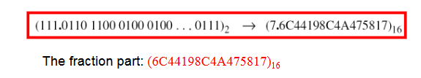
Round Constants (K₀ to K₇₉ )
There are 80 constants, K₀ to K₇₉ , each of 64 bits.
Similar to the initial values for the eight digest buffer, these values are calculated from the first 80 prime numbers (2, 3, …, 409).
NOTE: Cubic root of prime number, convert to hexa-deci, then consider the fraction part.
For example: The 80th prime is 409, with the cubic root
(409)^{1/3} = 7.42291412044.
Converting this number to binary with only 64 bits in the fraction part, we get:

